Slide 1
Training and Overfitting
MMCi Block 2
Matthew Engelhard

Slide 2
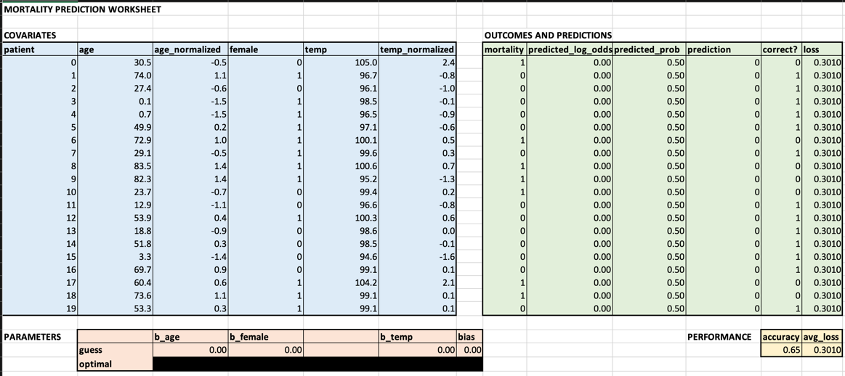
Strategy: determine how small changes in parameters affect the loss

Slide 3
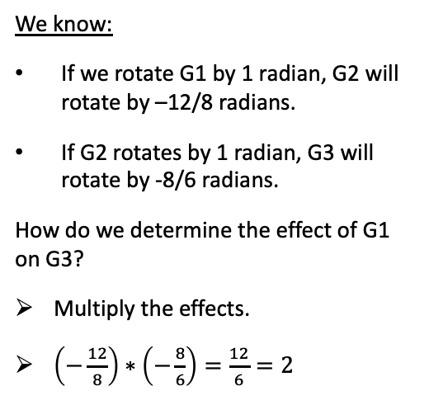
Strategy: determine how small changes in parameters affect the loss
We know:
If we rotate G1 by 1 radian, G2 will rotate by –12/8 radians.
If G2 rotates by 1 radian, G3 will rotate by -8/6 radians.
How do we determine the effect of G1 on G3?
Multiply the effects.
$\left(−\frac{12}{8}\right)∗\left(−\frac{8}{6}\right)=\frac{12}{6}=2$
G1
G2
G3

Slide 4
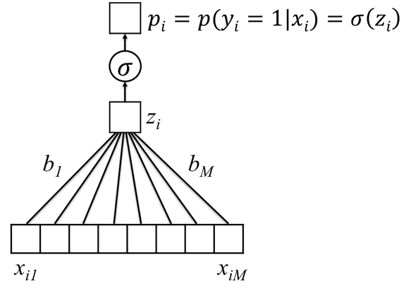
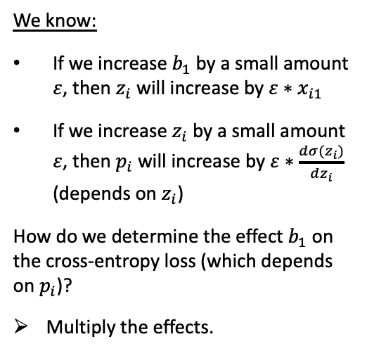
Strategy: determine how small changes in parameters affect the loss
We know:
If we increase $b_{1}$ by a small amount $ε$, then $z_{i}$ will increase by $ε∗x_{i1}$
If we increase $z_{i}$ by a small amount $ε$, then $p_{i}$ will increase by $ε∗\frac{dσ(z_{i})}{dz_{i}}$ (depends on $z_{i}$)
How do we determine the effect $b_{1}$ on the cross-entropy loss (which depends on $p_{i}$)?
Multiply the effects.

Slide 5
Strategy: determine how small changes in parameters affect the loss
This is called the chain rule (calc 101)
We use it to see how small changes in parameters affect the loss
Could be a very long chain…
Some parameters have a greater effect than others
We change all parameters at once, with each change proportional to that parameter’s effect on the loss
This is gradient descent

Slide 6
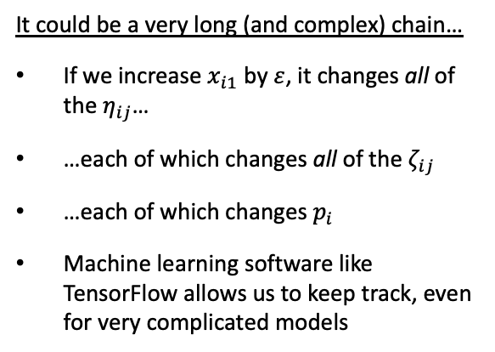
Strategy: determine how small changes in parameters affect the loss
It could be a very long (and complex) chain…
If we increase $x_{i1}$ by $ε$, it changes all of the $η_{ij}$…
…each of which changes all of the $ζ_{ij}$
…each of which changes $p_{i}$
Machine learning software like TensorFlow allows us to keep track, even for very complicated models

Slide 7
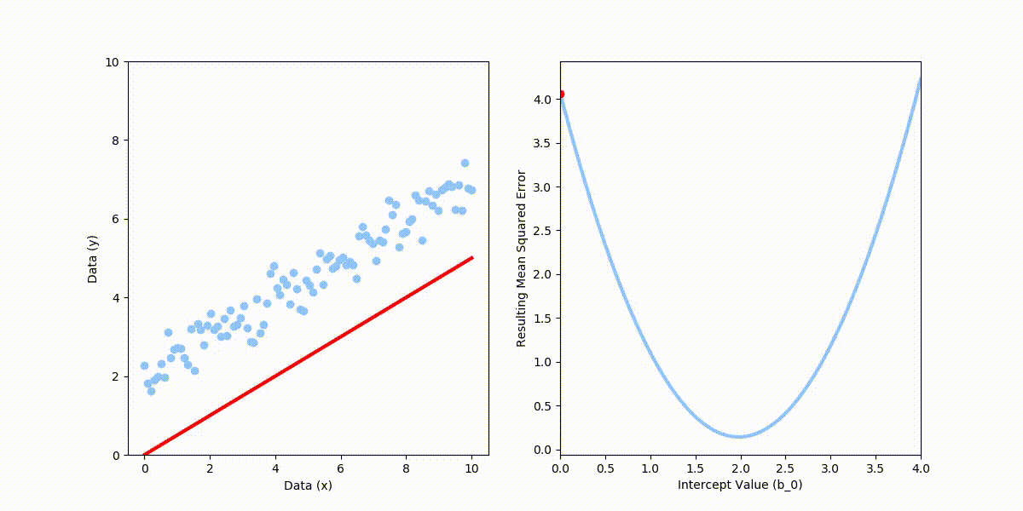
For simple models, minimizing the loss is easy.
There are a limited number of parameters to consider
Here, the loss is ‘bowl-shaped’, or convex; we can simply walk downhill from our current position
For linear regression, we can simply solve for the best parameters; but in general this is not true
Notes:
Important to note here – just because moving in one direction lowers the loss, doesn’t mean we can move in that direction indefinitely

Slide 8
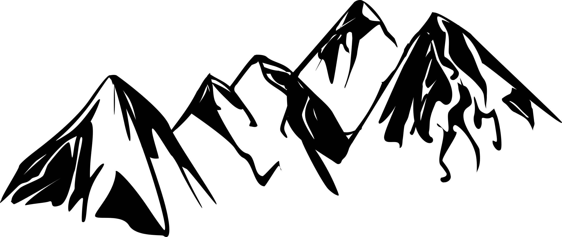

For complex models, it is much more difficult…
High-dimensional
Non-convex
No closed-form solution

Slide 9
…and we’re never sure we’ve found the best parameters

Slide 10


Learning in Neural Networks
With deep learning models, we are trying to minimize a function of many variables
Can’t visualize it
Can’t solve for the minimum directly
So, we follow the slope and hope for the best (i.e. gradient descent)
May end up in a low point that isn’t the lowest, i.e. local minimum
But, if we have lots of data, things usually work out OK

Slide 11
Overfitting

Slide 12
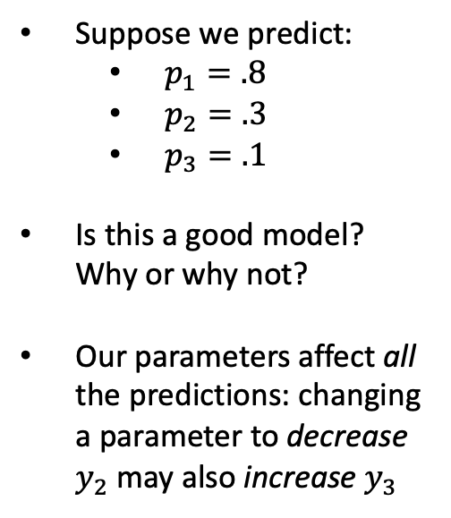
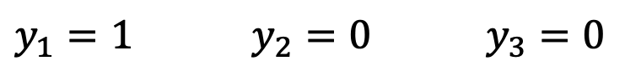
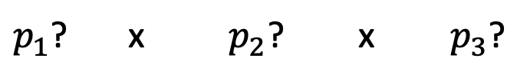
Recall: improving one prediction may worsen another
Suppose we predict:
$p_{1}=.8$
$p_{2}=.3$
$p_{3}=.1$
Is this a good model? Why or why not?
Our parameters affect all the predictions: changing a parameter to decrease $y_{2}$ may also increase $y_{3}$
$y_{1}=1$ $y_{2}=0$ $y_{3}=0$
(dies) (survives) (survives)
$p_{1}$? x $p_{2}$? x $p_{3}$?
Notes:
Root mean square error, normalized mean square error, etc, but these are the essentials
Other ways to measure distance between the prediction and the truth that might be appropriate for specific applications
Note that Normalized MSE is 1-R^2

Slide 13
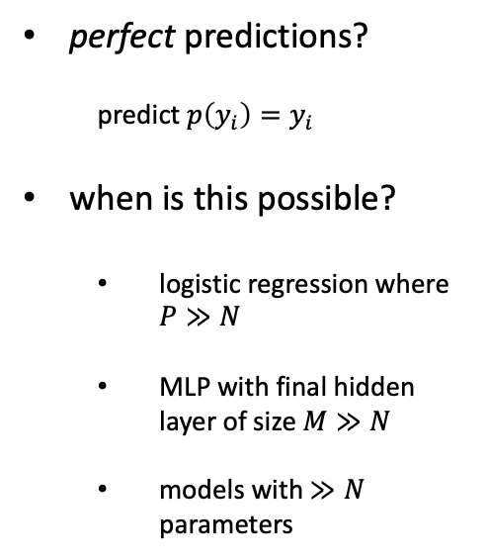
With a big a enough model, this is no longer true.
perfect predictions?
predict $p\left(y_{i}\right)=y_{i}$
when is this possible?
logistic regression where $P≫N$
MLP with final hidden layer of size $M≫N$
models with $≫N$ parameters
$y_{1}=1$ $y_{2}=0$ $y_{3}=0$
(dies) (survives) (survives)
$p_{1}$? x $p_{2}$? x $p_{3}$?
Notes:
Root mean square error, normalized mean square error, etc, but these are the essentials
Other ways to measure distance between the prediction and the truth that might be appropriate for specific applications
Note that Normalized MSE is 1-R^2

Slide 14
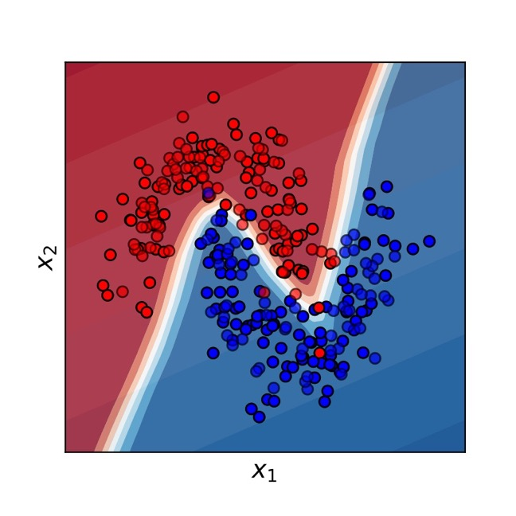
We like flexible, non-linear decision boundaries…

Slide 15
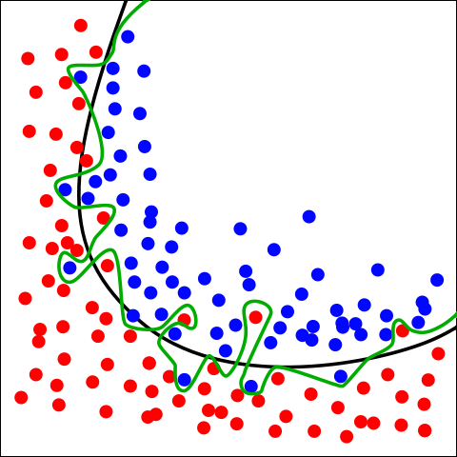
But when we start making our decision boundary arbitrarily complex to `fit’ the training set… this is overfitting
Green boundary:
Correct predictions for all training data
Very likely to be overfitting
Black boundary:
Balance between fit and model complexity
-> The black boundary is likely to perform better on new data
By Chabacano - Own work, CC BY-SA 4.0, https://commons.wikimedia.org/w/index.php?curid=3610704
Notes:
Willingness to embrace complex models → need this better approach to overfitting.

Slide 16
Overfitting
“Overfitting” happens when the learned model increases complexity to fit the observed training data too well – will not work to predict future data!
What would we want to use to fit these example data points?

Slide 17
Classic Example: Increasing Polynomial Order
Increasing complexity does not seem appropriate…
Notes:
Fair question: why is left better than right? If we knew that our observations were perfect, and that x was the only thing that affected y, then we’d need a function that goes through all points perfectly
But, there’s randomness. Or, at least there are things affecting y other than x.

Slide 18
With a complex enough model, we can typically predict our training labels perfectly.
The simpler model is likely
best with limited data
May be justified;
the validation set will tell us
Perfect predictions,
but unlikely to generalize
Notes:
Notice that the 8-order fit will take some big parameter values – we penalize them, we prevent this

Slide 19
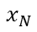
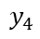
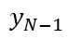
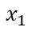
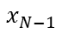
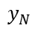
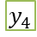
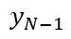
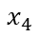
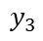
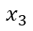
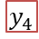
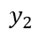
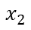
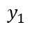
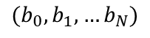
To protect against overfitting, see how well the model performs on previously unseen data.
Refine Model
$$x_{1}$$
$$y_{1}$$
$$x_{1}$$
$$y_{1}$$
$$x_{2}$$
$$y_{2}$$
$$x_{2}$$
$$y_{2}$$
$$x_{3}$$
$$y_{3}$$
$$x_{3}$$
$$y_{3}$$
$$x_{4}$$
$$y_{4}$$
$$x_{4}$$
$$y_{4}$$
$$x_{1}$$
$$y_{1}$$
$$x_{N−1}$$
$$x_{2}$$
$$y_{2}$$
$$x_{N−1}$$
$$y_{N−1}$$
$$x_{N}$$
$$y_{N}$$
$$x_{3}$$
$$y_{3}$$
$$x_{N}$$
$$y_{N}$$
Training Set
$$x_{4}$$
$$y_{4}$$
Test
$$x_{N−1}$$
$$y_{N−1}$$
$$x_{N}$$
$$y_{N}$$
$({b_{0},b}_{1},…b_{N})$
Validation
Estimate Performance on Validation Set
Final Performance Evaluation
Notes:
But, for all we know, the right-most model could be good. To find out? Try out some new data you haven’t seen before.

Slide 20
Early Stopping
During optimization, we can check the validation loss as we go.
Instead of optimizing to convergence, we can optimize until the validation loss stops improving
Saves computational cost
Performs better on validation (and test) sets
Widely used technique in the field
Best Validation (and Generalization) Here
Training Loss Keeps Improving

Slide 21
Other Ways to Use the Validation Set
Choosing between models (e.g. MLP, LR)
Choosing how strongly to regularize the model, i.e. penalize parameters
Choosing network depth, width, etc.
Many other “hyperparameters” we might tune

Slide 22
Conclusions
Learning consists in setting model parameters to maximize some measure of fit (or equivalently, minimize some loss)
This sounds easy, but is difficult in practice when working with complex models
Greater model complexity is often, but not always, advantageous
Proper model validation is critical to estimate real-world performance and prevent overfitting

